Slide 1
AgriGenius Intelligent Farming Solution using Deep Learning

Slide 2
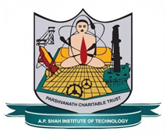
Department of Computer Science & Engineering (Artificial Intelligence & Machine Learning)
A.P. Shah Institute of Technology, G.B.Road, Kasarwadavli, Thane(W), Mumbai-400615, UNIVERSITY OF MUMBAI
Academic Year 2024-2025

Slide 3
Computer Science & Engineering Artificial Intelligence and Machine Learning By Aaryaman Kattali (22106077) Durvesh Kanade (22106013) Vaishnavi Dumbre (22106115) Sidra Khan (22106028) Under the Guidance of Prof. Vijaya Bharathi Jagan

Slide 4
Outline
Introduction
Objectives
Literature Survey
Limitations of the Existing Systems
Problem Statement
Proposed System Design
Framework/Algorithm
Technologies Stack for Proposed System
Details of Database / Input to the System
Implementation
Conclusion
References

Slide 5
Introduction
Need for Smart Farming: Traditional farming faces challenges like unpredictable weather, pests, and inefficient resource management. The increasing demand for food requires optimized agricultural practices.
Role of Deep Learning in Agriculture: Deep learning enables precision farming by analyzing large datasets from satellite images, drones, and IoT sensors. It helps in crop health monitoring.
AgriGenius: AI-powered smart farming solution that leverages deep learning for real-time agricultural insights. Provides farmers with data-driven recommendations to enhance productivity and sustainability.
RAG Chatbot provides disease diagnosis, treatment suggestions, and preventive measures based on real-time and historical data.

Slide 6
Objectives
To develop deep learning models for detecting plant diseases, pests, and nutrient deficiencies through image analysis.
Minimize losses due to diseases, pests, and unfavorable environmental conditions by providing early warnings and preventive measures.
Deliver quick, accurate, and easy-to-understand disease-related information, reducing farmers’ dependency on agricultural experts.
Allow farmers to upload images of affected crops for AI-powered analysis and precise diagnosis.

Slide 7
Literature Survey
Title | Year | Author | Description | Link
A Comprehensive Crop Recommendation System Integrating Machine Learning and Deep Learning Models | 2024 | A. Ghosh, S. K. Mohapatra, P. Pattanaik, P. K. Dash and S. Chakravarty | This study proposes a crop recommendation system using ML and DL to help farmers optimize yields based on soil and environmental factors | https://ieeexplore.ieee.org/document/10530724
Productive Crop Field Detection: A New Dataset and Deep Learning Benchmark Results | 2023 | Eduardo Nascimento, John Just, Jurandy Almeida, Tiago Almeida | This study introduces a dataset for crop field detection and benchmarks deep learning models to improve precision agriculture | https://arxiv.org/abs/2305.11990
Crop Disease Detection Using Deep Learning | 2019 | Omkar Kulkarni | This study develops a deep learning model using a public dataset of crop leaf images to classify diseases, showcasing AI’s role in plant diagnostics | https://ieeexplore.ieee.org/document/8697390

Slide 8
Literature Survey
Title | Year | Author | Description | Link
Crop Mapping from Image Time Series: Deep Learning with Multi-Scale Label Hierarchies | 2021 | Mehmet Ozgur Turkoglu, Stefano D'Aronco, Gregor Perich | This research employs deep learning and satellite image time series for crop mapping, using multi-scale label hierarchies to enhance crop classification over time. | https://arxiv.org/abs/2102.08820
Comprehensive Review on Machine Learning Algorithms for Plant Disease Detection | 2024 | P. Yerunkar, A. Ganer and K. Kalbande | This paper reviews ML and DL techniques for plant disease detection, highlighting their advantages over manual methods and comparing recent deep learning models. | https://ieeexplore.ieee.org/document/10716068

Slide 9
Limitations of the existing system
Manual Disease Diagnosis is Time-Consuming.
Limited Accessibility in Rural Areas.
Many AI-based solutions require high-speed internet and smartphones, which may not be available to all farmers.
Some systems struggle with detecting multiple diseases affecting a crop simultaneously, leading to incomplete diagnosis.

Slide 10
Problem Statement
Farmers struggle with early crop disease detection, leading to yield loss. Traditional methods are slow and require experts. AgriGenius, an AI-powered tool, provides real-time disease diagnosis using deep learning and image analysis, offering instant treatment recommendations to improve crop health and productivity.

Slide 11
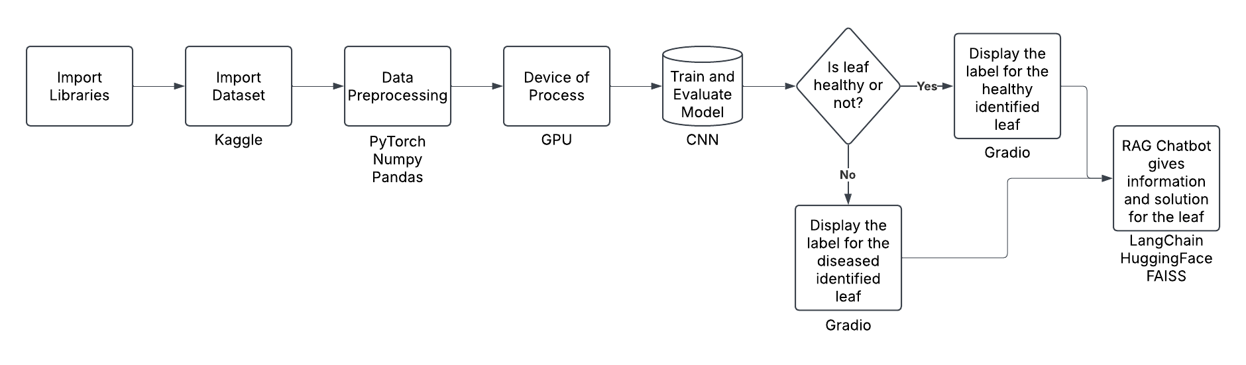
Flowchart

Slide 12
System Design
Input Acquisition
Users upload RGB images of plant leaves through a Gradio-based web interface
Images are pre-processed by resizing to 256×256 pixels and normalizing them into tensors suitable for the neural network
Model Processing
A custom CNN with ResNet-inspired architecture (called CNN_NeuralNet) processes the images
Images are processed in batches of 32
Predicted Output
The system outputs classification probabilities across all disease classes
Once a disease is detected, the system activates a RAG (Retrieval-Augmented Generation) chatbot

Slide 13
RAG (Retrieval-Augmented Generation) Chatbot
Knowledge Base: A comprehensive database of plant disease information including:
Disease descriptions
Symptoms
Treatment recommendations
Prevention strategies.
LLM Integration: Uses Mistral-7B-Instruct model from HuggingFace for text generation.
Retrieval System: FAISS vector store with sentence-transformer embeddings.
Conversation Flow: After disease detection, users can ask questions about the disease.

Slide 14



Technology Stack for Proposed System
PyTorch → Deep learning framework
Pandas, NumPy, PIL → Data Handling
LangChain, HuggingFaceHub, FAISS → LLM and RAG
Matplotlib → Data visualization
OS & Shutil → System related procedures
Gradio → Frontend UI

Slide 15
Details of Database
Dataset Source: New Plant Diseases Dataset from Kaggle, downloaded via kagglehub.dataset_download("vipoooool/new-plant-diseases-dataset").
Data Format: RGB images of plant leaves organized into folders representing different diseases.
Dataset Structure:
Training data: Located in /New Plant Diseases Dataset(Augmented)/train
Validation data: Located in /New Plant Diseases Dataset(Augmented)/valid
Test data: Located in /test
Classes: Multiple disease classes across different plant species (e.g., "Apple___Apple_scab", "Tomato___Late_blight").

Slide 16
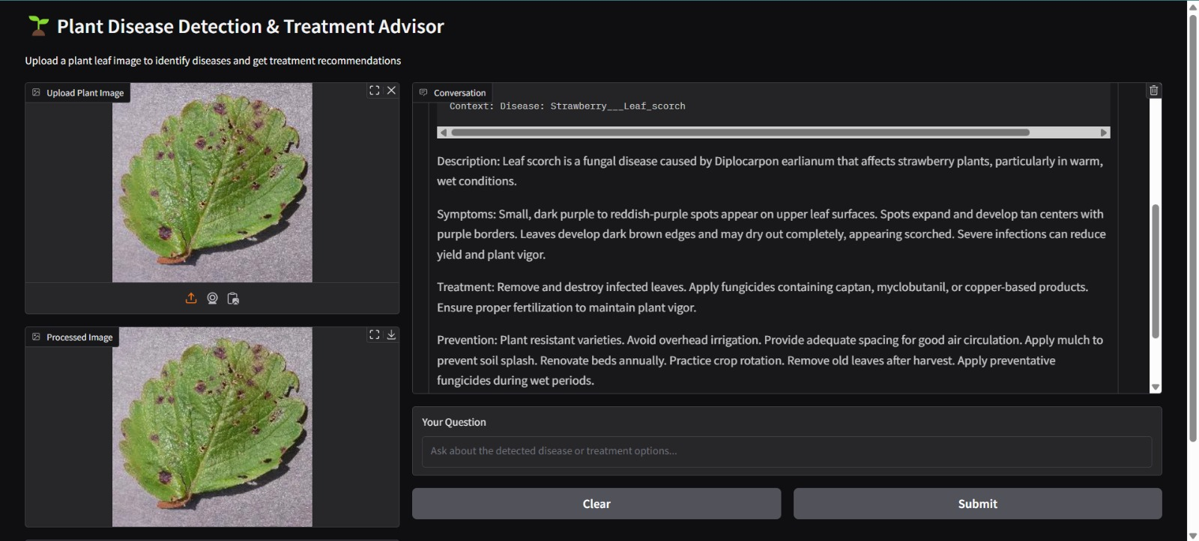
Implementation

Slide 17
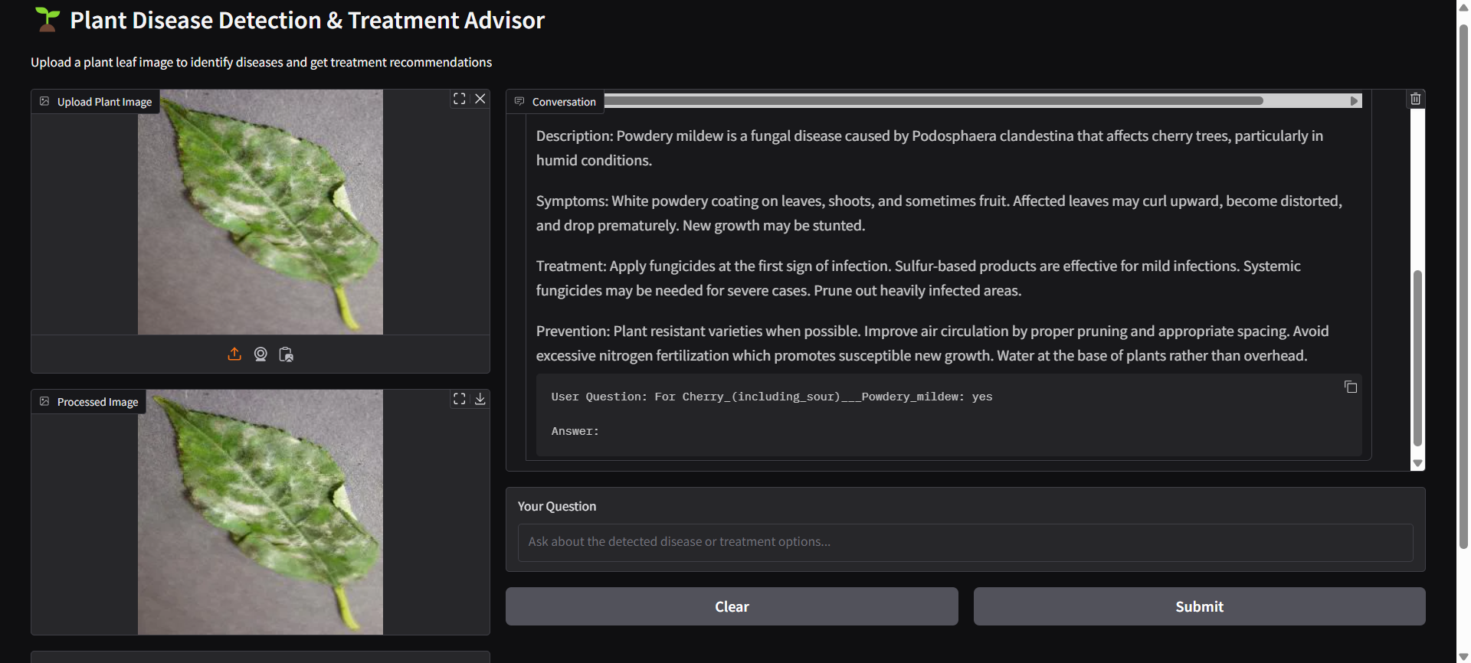
Implementation

Slide 18
Conclusion
The Chatbot-Based Crop Disease Prediction System uses AI-powered image analysis and NLP to provide real-time disease diagnosis and treatment recommendations. It enhances accessibility for farmers, reducing reliance on experts. While challenges like internet dependency and image variability exist, future improvements in offline access, multilingual support, and voice interaction can enhance usability. This system has the potential to boost precision agriculture, reduce crop losses, and improve farm productivity, contributing to sustainable agriculture.

Slide 19
References
[1] A. Ghosh, S. K. Mohapatra, P. Pattanaik, P. K. Dash and S. Chakravarty, "A Comprehensive Crop Recommendation System Integrating Machine Learning and Deep Learning Models," 2024 1st International Conference on Cognitive, Green and Ubiquitous Computing (IC-CGU), Bhubaneswar, India, 2024, pp. 1-6, doi: 10.1109/IC-CGU58078.2024.10530724
[2] Nascimento, E., Just, J., Almeida, J., & Almeida, T. (2023). Productive Crop Field Detection: A New Dataset and Deep Learning Benchmark Results. IEEE Geoscience and Remote Sensing Letters.
[3] O. Kulkarni, "Crop Disease Detection Using Deep Learning," 2018 Fourth International Conference on Computing Communication Control and Automation (ICCUBEA), Pune, India, 2018, pp. 1-4, doi: 10.1109/ICCUBEA.2018.8697390
[4] Turkoglu, M. O., D'Aronco, S., Perich, G., Liebisch, F., Streit, C., Schindler, K., & Wegner, J. D. (2021). Crop mapping from image time series: deep learning with multi-scale label hierarchies. arXiv preprint arXiv:2102.08820
[5] P. Yerunkar, A. Ganer and K. Kalbande, "Comprehensive Review on Machine Learning Algorithms for Plant Disease Detection," 2024 Parul International Conference on Engineering and Technology (PICET), Vadodara, India, 2024, pp. 1-5, doi: 10.1109/PICET60765.2024.10716068.

Slide 20
THANK YOU!

